Slide 1
Deep Learning

Slide 2
DEEP LEARNING
Deep learning is a sub field of Machine Learning that very closely tries to mimic human brain's working using neurons.
These techniques focus on building Artificial Neural Networks (ANN) using several hidden layers.
There are variety of deep learning networks such as Multilayer Perceptron ( MLP), Autoencoders (AE), Convolution Neural Network (CNN), Recurrent Neural Network (RNN).

Slide 3
Why DEEP LEARNING is Growing?
Processing power needed for Deep learning is readily becoming available using GPUs, Distributed Computing and powerful CPUs
Moreover, as the data amount grows, Deep Learning models seem to outperform Machine Learning models
Focus on customization and real time decisioning
Uncover hard to detect patterns (using traditional techniques). Find latent features (super variables) without significant manual feature engineering.

Slide 4
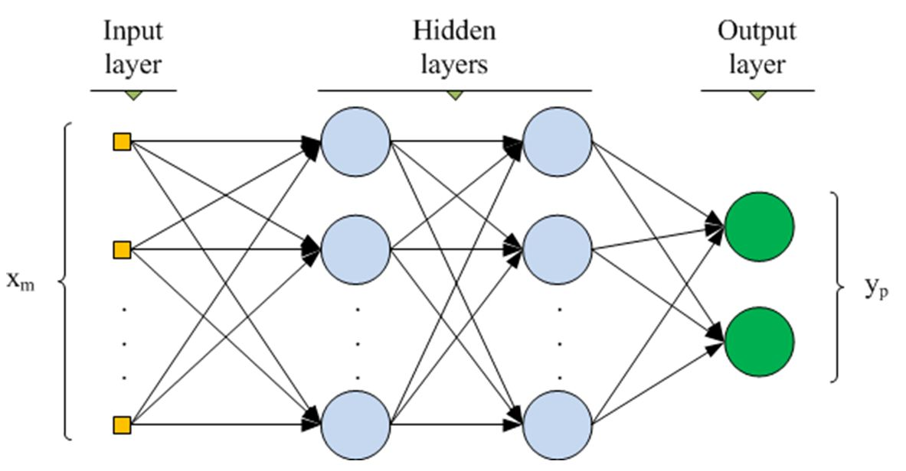
Building Blocks of Deep Learning
Multilayer Perceptron (MLP)
These are the most basic networks and feed forward the inputs to create output.
They consist of an input layer and an output layer and many interconnected hidden layers and neurons between the input and the output layers.
They generally use some non linear activation function such as Relu or Tanh and compute the losses (the difference between the true output and computed output) such as Mean Square Error ( MSE), Logloss.
This loss is backward propagated to adjust the weights and training to minimize the losses or make the models more accurate.
A ( WX+B )

Slide 5
Autoencoders
The concept of the AE is quite simple- the input vectors are used to compute the output vectors, but output vectors are same as the input vectors.
Autoencoders are neural networks that learn to efficiently compress and encode data then learn to reconstruct the data back from the reduced encoded representation to a representation that is as close to the original input as possible.
Therefore, autoencoders reduce the dimensionality of the input data i.e. reducing the number of features that describe input data.

Slide 6
Convolution Neural Network
Convolution Neural Networks (CNN) significantly enhances the capabilities of the feed forward network such as MLP by inserting convolution layers.
They are particularly suitable for spatial data, object recognition and image analysis using multidimensional neurons structures.
CNNs use convolutions ( a linear operation) rather than matrix multiplication as in MLP
Typically a CNN will have three stages- convolution stage, detector layer ( non linear activator) and pooling layer

Slide 7
Convolution Neural Network
Convolution Layer- The most important component in the CNN. The layer has Kernels ( learnable filters) and the input x and y dimensions are convoluted ( dot product) to generate feature map
Detector Layer- The feature maps are passed to this stage using a not linear activation function such as ReLU activation function to accentuate the non linear components of the feature maps
Pooling Layer- A pooling layer such as “max pooling” summarizes (sub-sampling) the responses from several inputs from the previous layer and serves to reduce the size of the spatial representation.

Slide 8
Convolution Neural Network
Pooling: This is basically done to reduce the number of parameters to learn and prevents overfitting. Thus, it reduces the number of parameters to learn and the amount of computation performed in the network.
Pooling is then applied over the feature maps for invariance to translation.
Types of Pooling: Max Pooling, Min Pooling and Average Pooling
Max pooling provides better performance compared to min or average pooling.

Slide 9

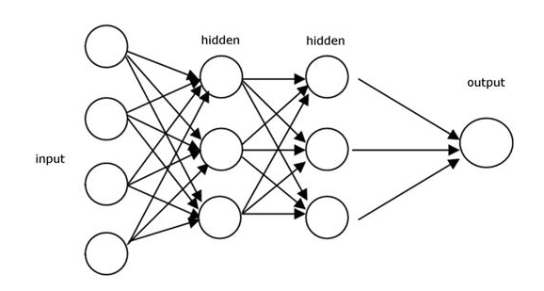

Deep Neural Networks for Images
Cat? (0/1)
Parameter Explosion
64×64×3
= 12288
1000×1000×3
= 3 million
Notes:
https://www.bilibili.com/video/av35144344?from=search&seid=17331048203484303976
3：18

Slide 10


Why CNN for Image?
Some patterns are much smaller than the whole image
A neuron does not have to see the whole image to discover the pattern.
Connecting to small region with less parameters
“beak” detector

Slide 11

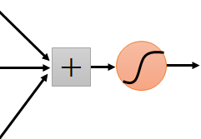
Why CNN for Image?
The same patterns appear in different regions.
“upper-left beak” detector
Do almost the same thing
They can use the same set of parameters.
“middle beak” detector

Slide 12


The whole CNN
cat dog ……
Convolution
Max Pooling
Can repeat many times
Fully Connected Feedforward network
Convolution
Max Pooling
Flatten

Slide 13
The whole CNN
Property 1
Some patterns are much smaller than the whole image
Convolution
Property 2
Max Pooling
The same patterns appear in different regions.
Can repeat many times
Property 3
Convolution
Subsampling the pixels will not change the object
Max Pooling
Flatten

Slide 14
The whole CNN
cat dog ……
Convolution
Max Pooling
Can repeat many times
Fully Connected Feedforward network
Convolution
Max Pooling
Flatten

Slide 15
CNN – Convolution
Those are the network parameters to be learned.
1 | -1 | -1
-1 | 1 | -1
-1 | -1 | 1
1 | 0 | 0 | 0 | 0 | 1
0 | 1 | 0 | 0 | 1 | 0
0 | 0 | 1 | 1 | 0 | 0
1 | 0 | 0 | 0 | 1 | 0
0 | 1 | 0 | 0 | 1 | 0
0 | 0 | 1 | 0 | 1 | 0
Filter 1
Matrix
-1 | 1 | -1
-1 | 1 | -1
-1 | 1 | -1
Filter 2
Matrix
……
6 x 6 image
Property 1
Each filter detects a small pattern (3 x 3).

Slide 16
CNN – Convolution
1 | -1 | -1
-1 | 1 | -1
-1 | -1 | 1
Filter 1
stride=1
1 | 0 | 0 | 0 | 0 | 1
0 | 1 | 0 | 0 | 1 | 0
0 | 0 | 1 | 1 | 0 | 0
1 | 0 | 0 | 0 | 1 | 0
0 | 1 | 0 | 0 | 1 | 0
0 | 0 | 1 | 0 | 1 | 0
3
-1
6 x 6 image

Slide 17
CNN – Convolution
1 | -1 | -1
-1 | 1 | -1
-1 | -1 | 1
Filter 1
If stride=2
1 | 0 | 0 | 0 | 0 | 1
0 | 1 | 0 | 0 | 1 | 0
0 | 0 | 1 | 1 | 0 | 0
1 | 0 | 0 | 0 | 1 | 0
0 | 1 | 0 | 0 | 1 | 0
0 | 0 | 1 | 0 | 1 | 0
3
-3
We set stride=1 below
6 x 6 image

Slide 18
CNN – Convolution
1 | -1 | -1
-1 | 1 | -1
-1 | -1 | 1
Filter 1
stride=1
1 | 0 | 0 | 0 | 0 | 1
0 | 1 | 0 | 0 | 1 | 0
0 | 0 | 1 | 1 | 0 | 0
1 | 0 | 0 | 0 | 1 | 0
0 | 1 | 0 | 0 | 1 | 0
0 | 0 | 1 | 0 | 1 | 0
3
-1
-3
-1
-3
1
0
-3
-3
-3
0
1
3
-2
-2
-1
6 x 6 image
Property 2

Slide 19
CNN – Convolution
-1 | 1 | -1
-1 | 1 | -1
-1 | 1 | -1
Filter 2
stride=1
Do the same process for every filter
1 | 0 | 0 | 0 | 0 | 1
0 | 1 | 0 | 0 | 1 | 0
0 | 0 | 1 | 1 | 0 | 0
1 | 0 | 0 | 0 | 1 | 0
0 | 1 | 0 | 0 | 1 | 0
0 | 0 | 1 | 0 | 1 | 0
3
-1
-3
-1
-1
-1
-1
-1
-3
1
0
-3
-1
-1
-2
1
Feature
Map
-3
-3
0
1
-1
-1
-2
1
3
-2
-2
-1
6 x 6 image
-1
0
-4
3
4 x 4 image

Slide 20

CNN – Convolution

Slide 21
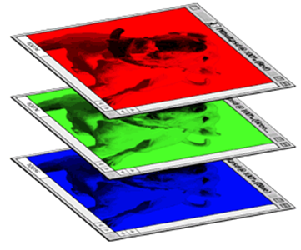
CNN – Colorful image
1 | -1 | -1
-1 | 1 | -1
-1 | -1 | 1
-1 | 1 | -1
-1 | 1 | -1
-1 | 1 | -1
1 | -1 | -1
-1 | 1 | -1
-1 | -1 | 1
-1 | 1 | -1
-1 | 1 | -1
-1 | 1 | -1
1 | -1 | -1
-1 | 1 | -1
-1 | -1 | 1
-1 | 1 | -1
-1 | 1 | -1
-1 | 1 | -1
Filter 1
Filter 2
Colorful image
1 | 0 | 0 | 0 | 0 | 1
0 | 1 | 0 | 0 | 1 | 0
0 | 0 | 1 | 1 | 0 | 0
1 | 0 | 0 | 0 | 1 | 0
0 | 1 | 0 | 0 | 1 | 0
0 | 0 | 1 | 0 | 1 | 0
1 | 0 | 0 | 0 | 0 | 1
0 | 1 | 0 | 0 | 1 | 0
0 | 0 | 1 | 1 | 0 | 0
1 | 0 | 0 | 0 | 1 | 0
0 | 1 | 0 | 0 | 1 | 0
0 | 0 | 1 | 0 | 1 | 0
1 | 0 | 0 | 0 | 0 | 1
0 | 1 | 0 | 0 | 1 | 0
0 | 0 | 1 | 1 | 0 | 0
1 | 0 | 0 | 0 | 1 | 0
0 | 1 | 0 | 0 | 1 | 0
0 | 0 | 1 | 0 | 1 | 0

Slide 22
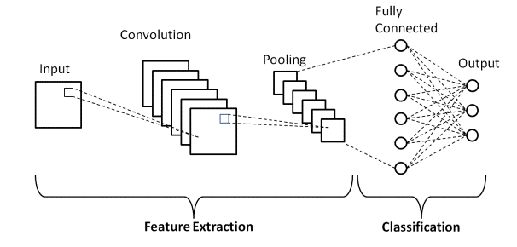
Fully Connected Layer
This layer basically takes an input from its preceding layer and outputs an N dimensional vector where N is the number of classes.
So, it is called flatten all the input and pass these flattened inputs to a deep neural network that outputs the class of the object.

Slide 23
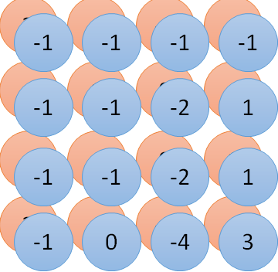
Convolution v.s. Fully Connected
1 | 0 | 0 | 0 | 0 | 1
0 | 1 | 0 | 0 | 1 | 0
0 | 0 | 1 | 1 | 0 | 0
1 | 0 | 0 | 0 | 1 | 0
0 | 1 | 0 | 0 | 1 | 0
0 | 0 | 1 | 0 | 1 | 0
1 | -1 | -1
-1 | 1 | -1
-1 | -1 | 1
-1 | 1 | -1
-1 | 1 | -1
-1 | 1 | -1
convolution
image
1 | 0 | 0 | 0 | 0 | 1
0 | 1 | 0 | 0 | 1 | 0
0 | 0 | 1 | 1 | 0 | 0
1 | 0 | 0 | 0 | 1 | 0
0 | 1 | 0 | 0 | 1 | 0
0 | 0 | 1 | 0 | 1 | 0
Fully-connected
……
……

Slide 24
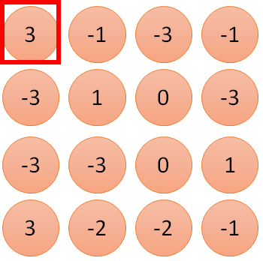
1 | -1 | -1
-1 | 1 | -1
-1 | -1 | 1
1:
1
Filter 1
2:
0
3:
0
3
4:
0
1 | 0 | 0 | 0 | 0 | 1
0 | 1 | 0 | 0 | 1 | 0
0 | 0 | 1 | 1 | 0 | 0
1 | 0 | 0 | 0 | 1 | 0
0 | 1 | 0 | 0 | 1 | 0
0 | 0 | 1 | 0 | 1 | 0
…
7:
0
8:
1
9:
0
10:
0
…
13:
0
6 x 6 image
14:
0
Less parameters!
15:
Only connect to 9 input, not fully connected
1
16:
1
…

Slide 25
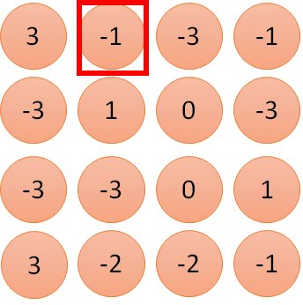
CNN – Convolution
1 | -1 | -1
-1 | 1 | -1
-1 | -1 | 1
1:
1
Filter 1
2:
0
3:
0
3
4:
0
1 | 0 | 0 | 0 | 0 | 1
0 | 1 | 0 | 0 | 1 | 0
0 | 0 | 1 | 1 | 0 | 0
1 | 0 | 0 | 0 | 1 | 0
0 | 1 | 0 | 0 | 1 | 0
0 | 0 | 1 | 0 | 1 | 0
…
7:
0
8:
1
-1
9:
0
0
…
13:
0
6 x 6 image
14:
0
Less parameters!
15:
1
16:
1
Shared weights
Even less parameters!
…

Slide 26
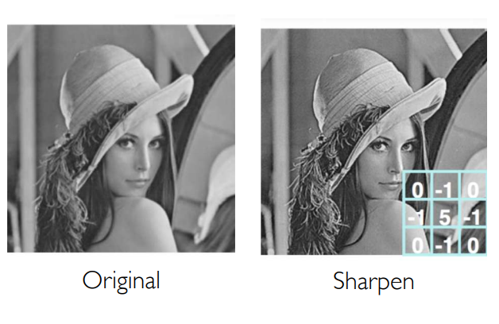
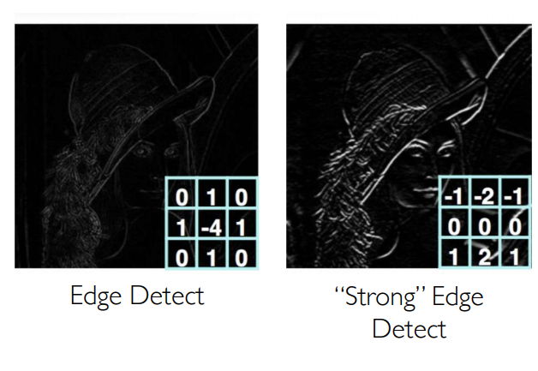
Producing Feature Maps

Slide 27
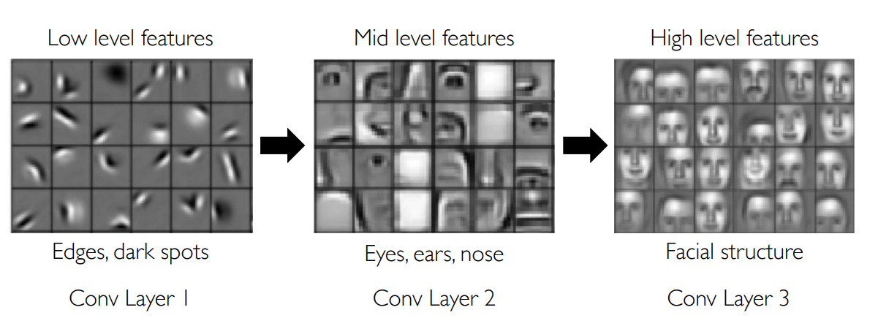
Representation Learning in Deep CNNs

Slide 28
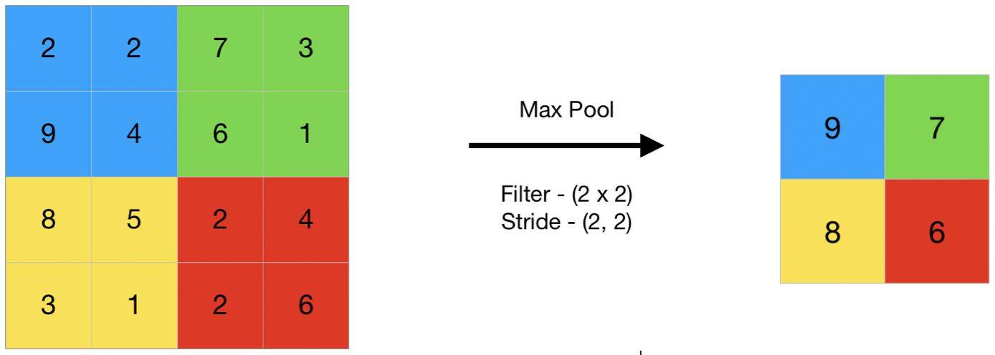
Convolution Neural Network
Max Pooling:

Slide 29
CNN – Max Pooling
1 | -1 | -1
-1 | 1 | -1
-1 | -1 | 1
-1 | 1 | -1
-1 | 1 | -1
-1 | 1 | -1
Filter 1
Filter 2
3
-1
-3
-1
-1
-1
-1
-1
-3
1
0
-3
-1
-1
-2
1
-3
-3
0
1
-1
-1
-2
1
3
-2
-2
-1
-1
0
-4
3

Slide 30
CNN – Max Pooling
1 | 0 | 0 | 0 | 0 | 1
0 | 1 | 0 | 0 | 1 | 0
0 | 0 | 1 | 1 | 0 | 0
1 | 0 | 0 | 0 | 1 | 0
0 | 1 | 0 | 0 | 1 | 0
0 | 0 | 1 | 0 | 1 | 0
Conv
3
0
-1
1
Max
Pooling
3
1
0
3
2 x 2 image
6 x 6 image
New image
but smaller
Each filter
is a channel

Slide 31
The whole CNN
3
0
-1
1
Convolution
3
1
0
3
Max Pooling
Can repeat many times
A new image
Convolution
Smaller than the original image
The number of the channel is the number of filters
Max Pooling

Slide 32
The whole CNN
cat dog ……
Convolution
Max Pooling
A new image
Fully Connected Feedforward network
Convolution
Max Pooling
A new image
Flatten

Slide 33
Flatten
3
0
1
3
0
1
3
-1
3
1
-1
Flatten
0
3
1
Fully Connected Feedforward network
0
3

Slide 34
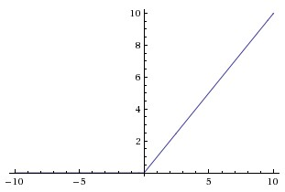
Activation - Rectified linear(Relu)
Computes f(x) = max(0,x)
What happens when x = -10?
What happens when x = 0?
What happens when x = 10?

Slide 35
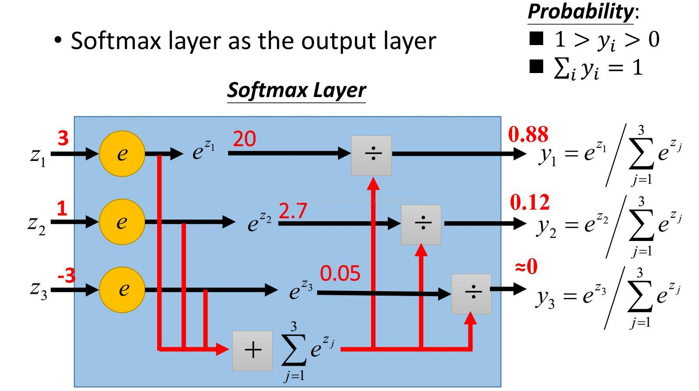
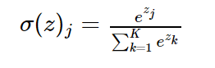
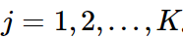
Softmax
If we take an input of [1,2,3,4,1,2,3], the softmax of that is [0.024, 0.064, 0.175, 0.475, 0.024, 0.064, 0.175].
The softmax function highlights the largest values and suppress other values.

Slide 36
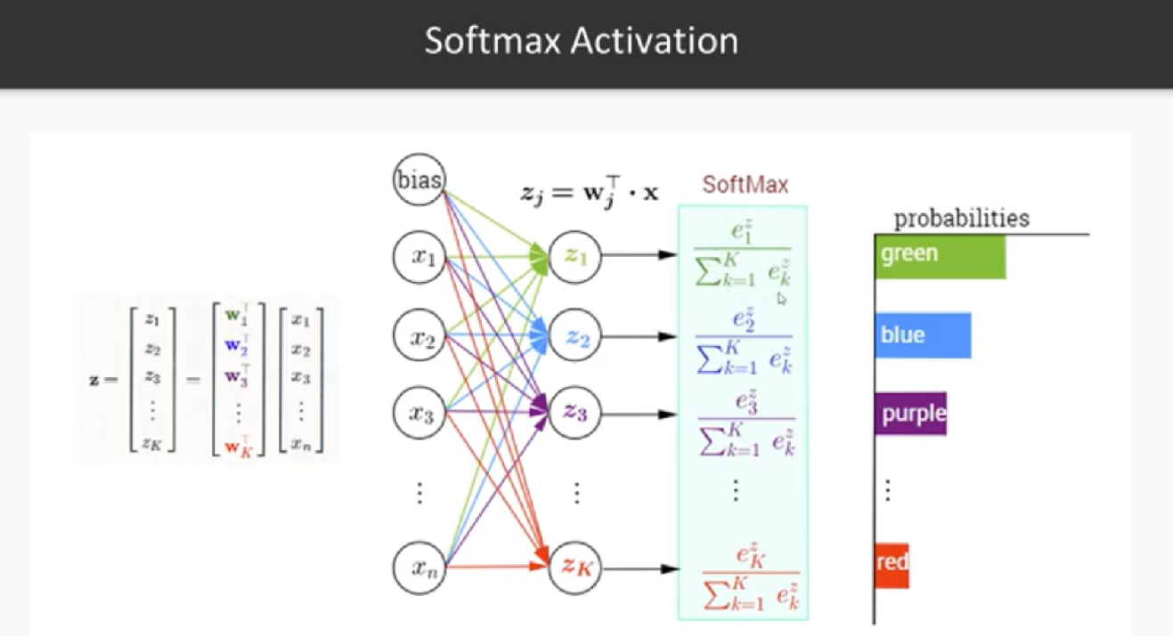

Slide 37
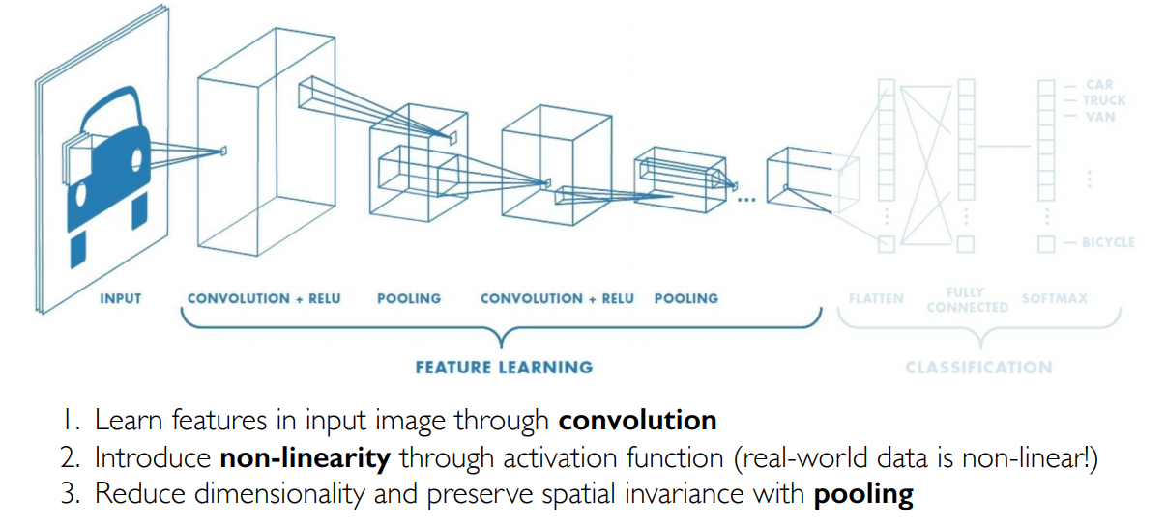
CNNs for Classification: Feature Learning

Slide 38
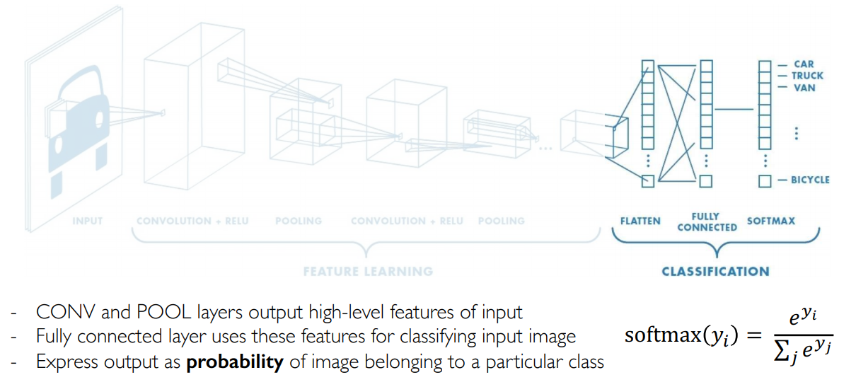
CNNs for Classification: Class Probabilities

Slide 39
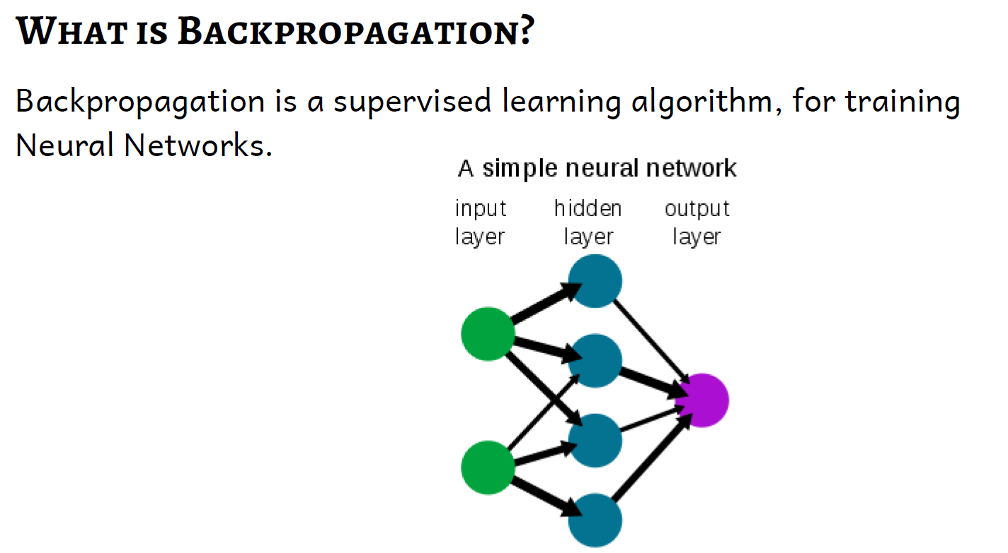

Slide 40
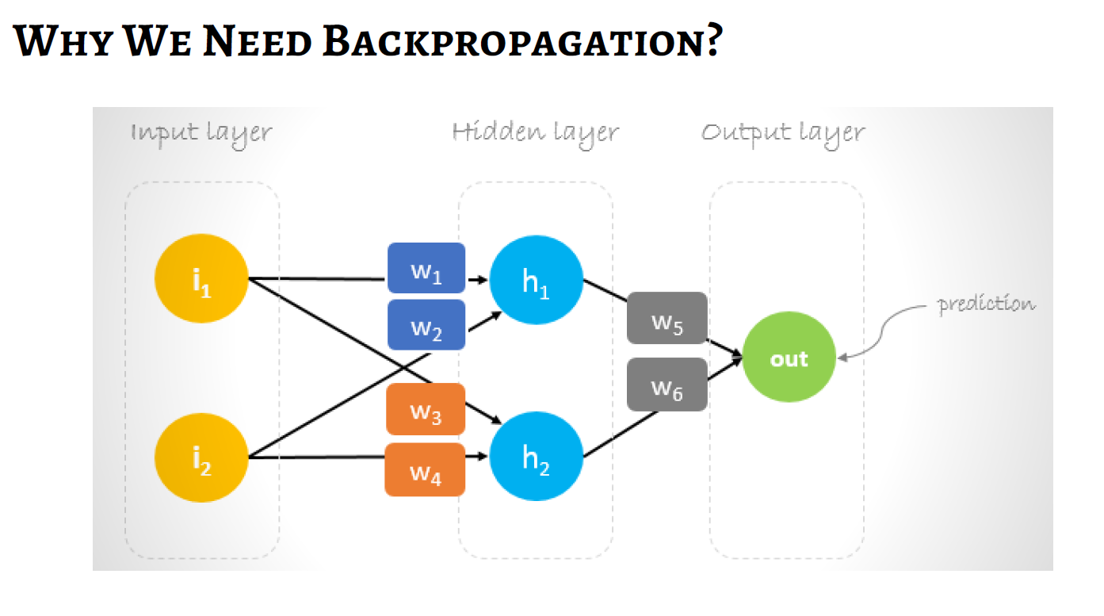

Slide 41
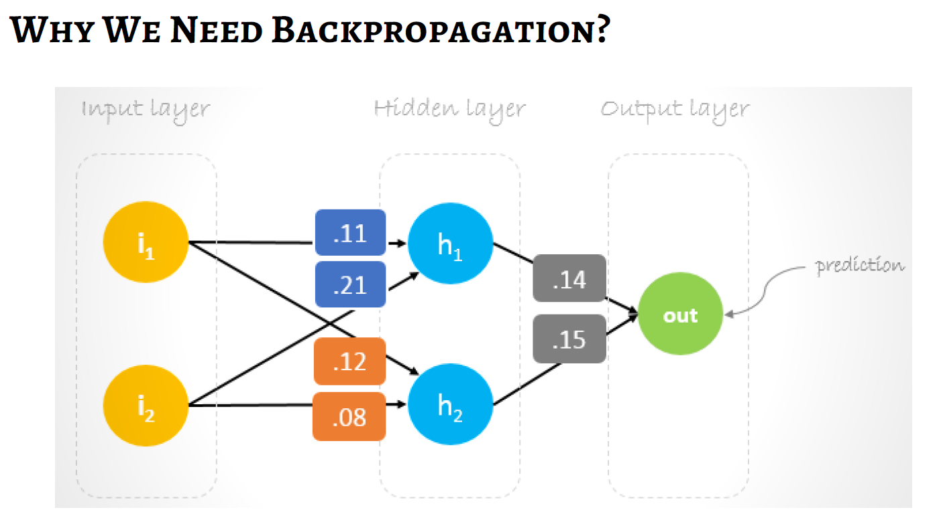

Slide 42
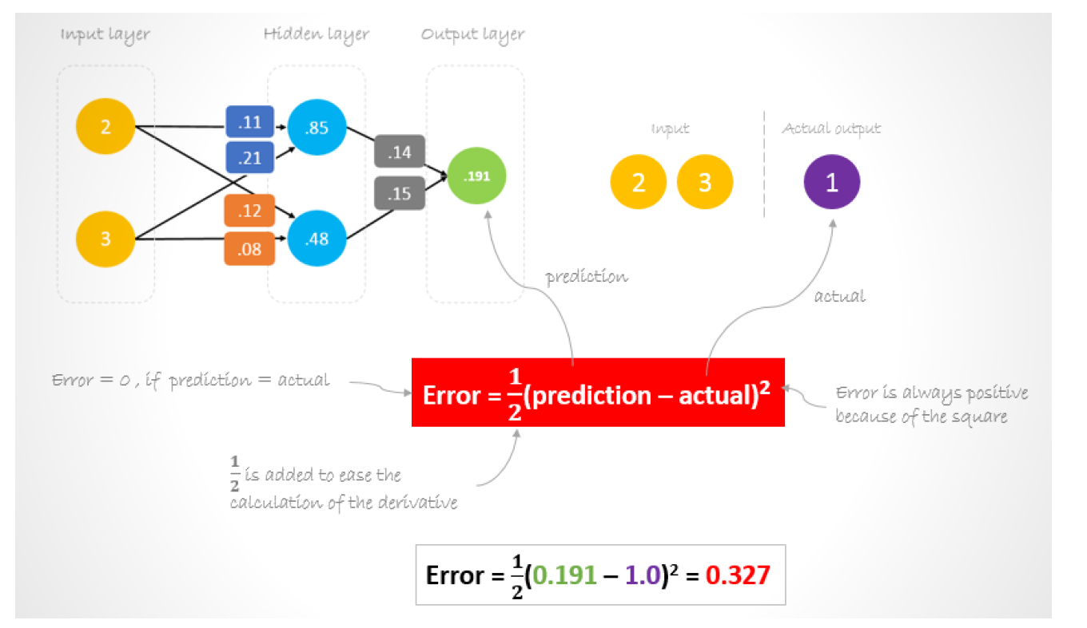

Slide 43
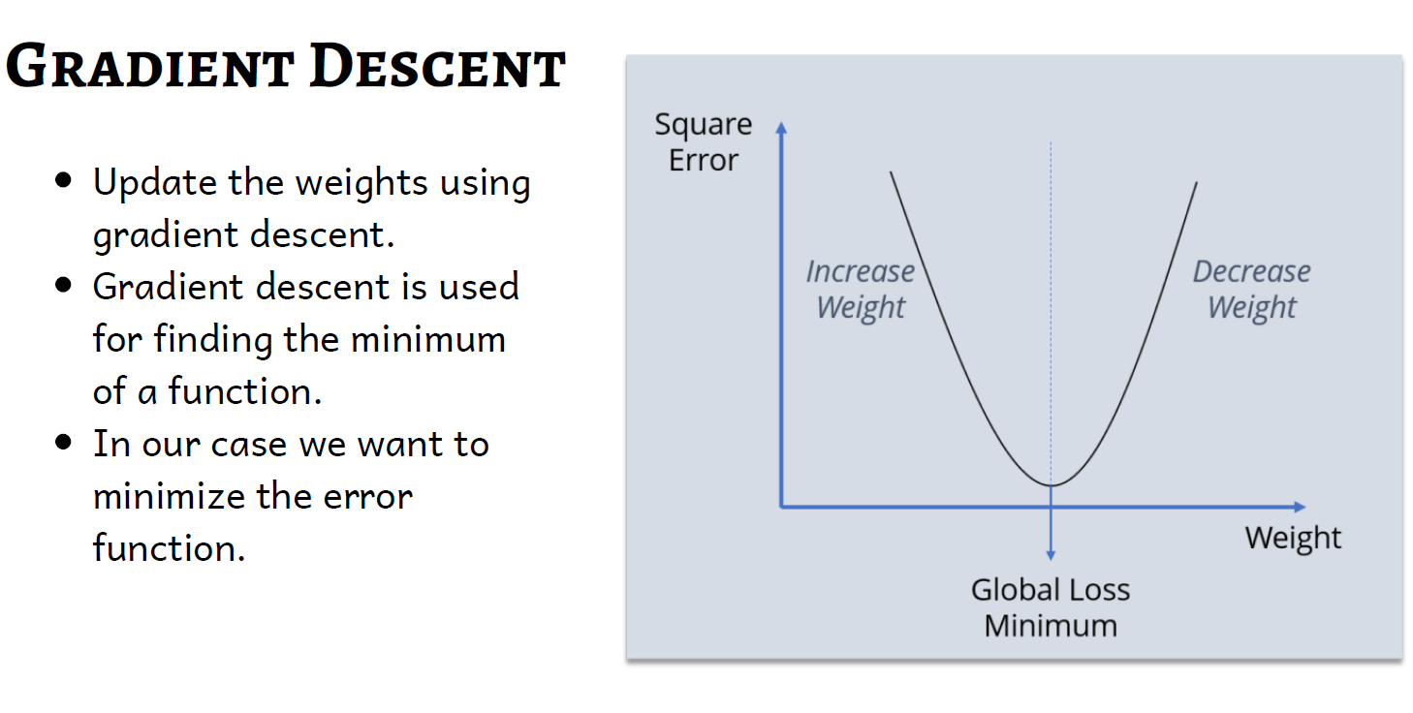

Slide 44
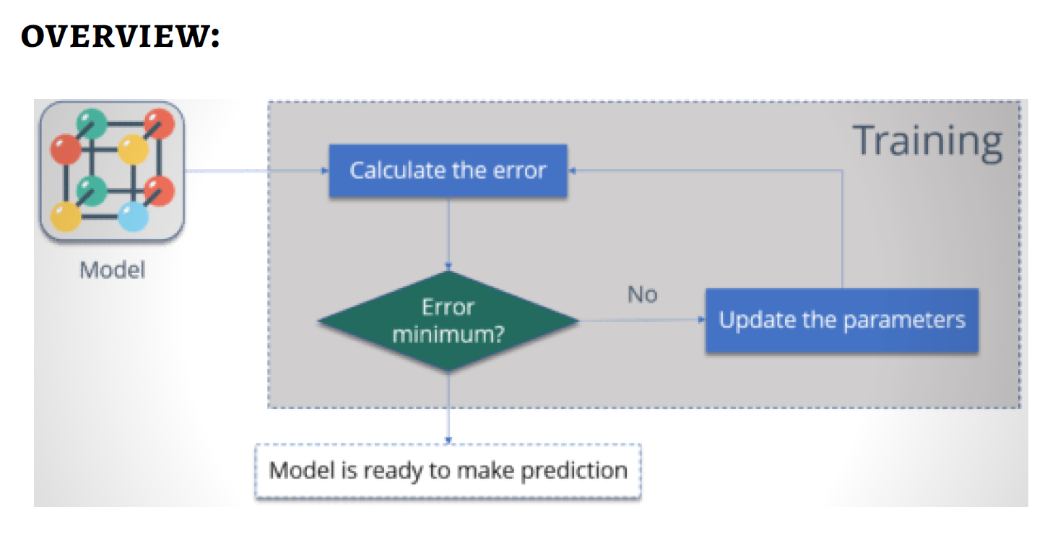

Slide 45
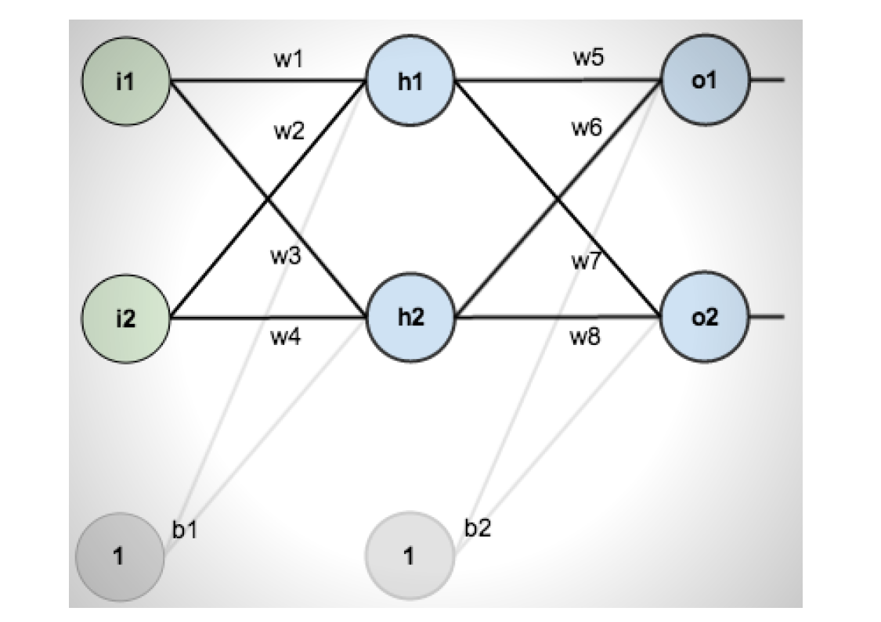

Slide 46
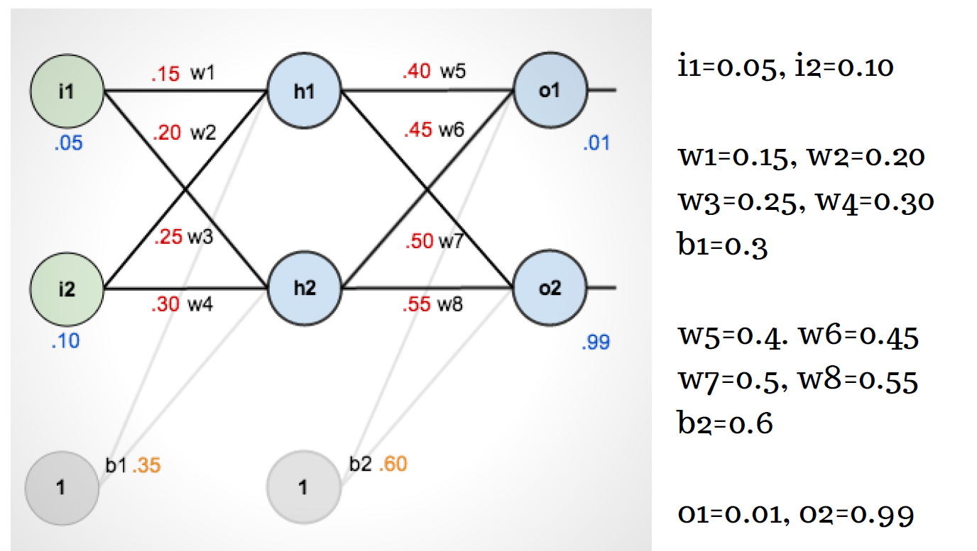

Slide 47
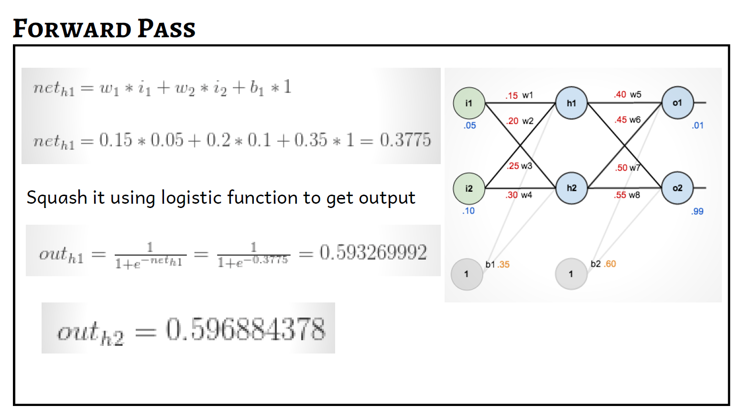

Slide 48
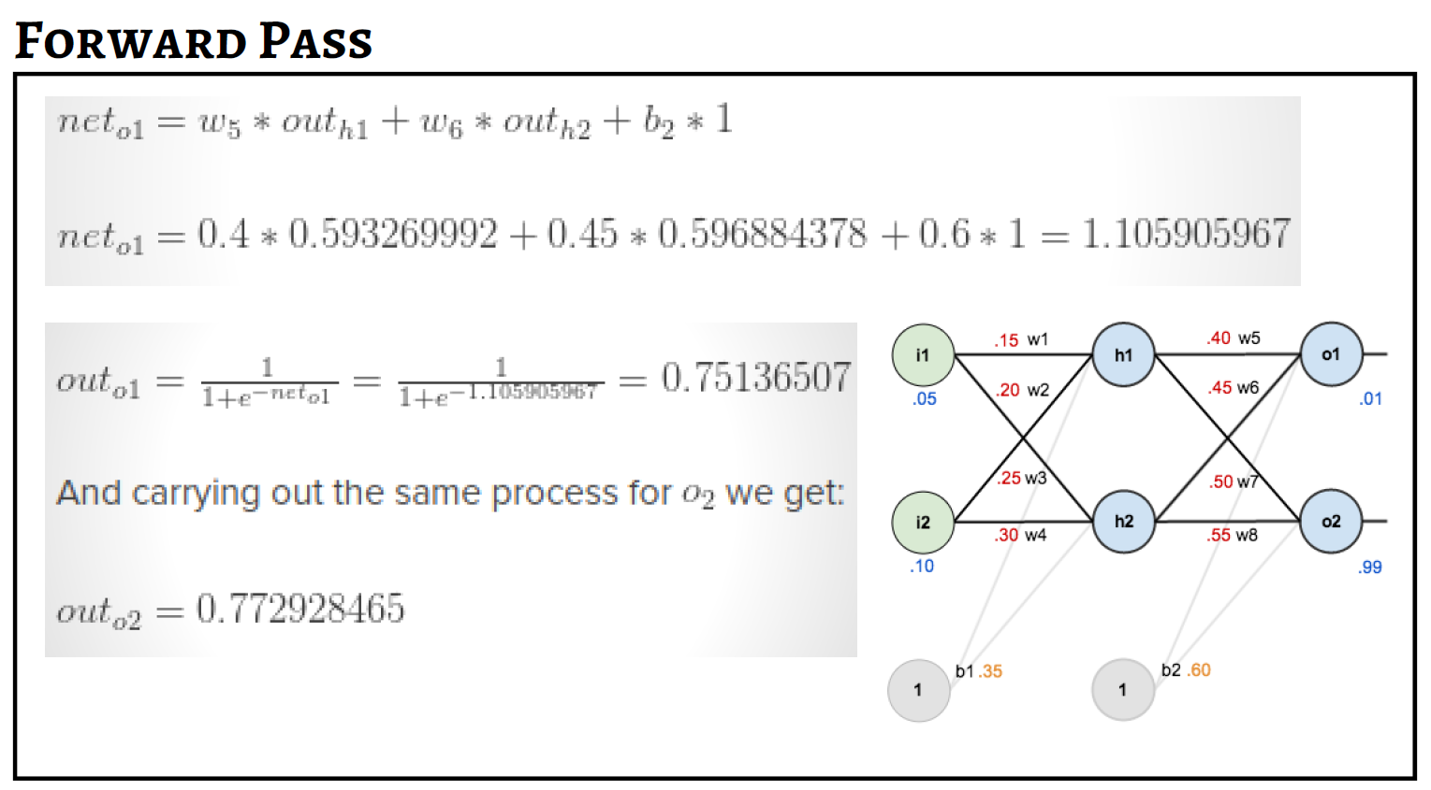

Slide 49
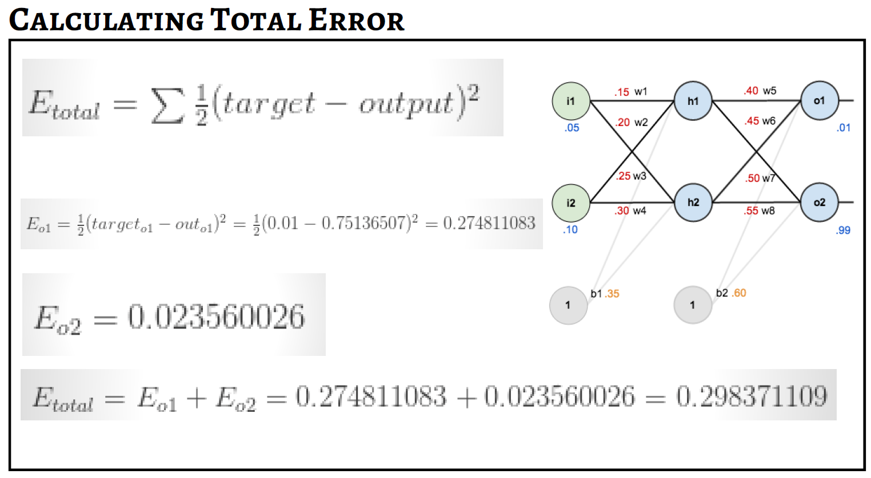

Slide 50
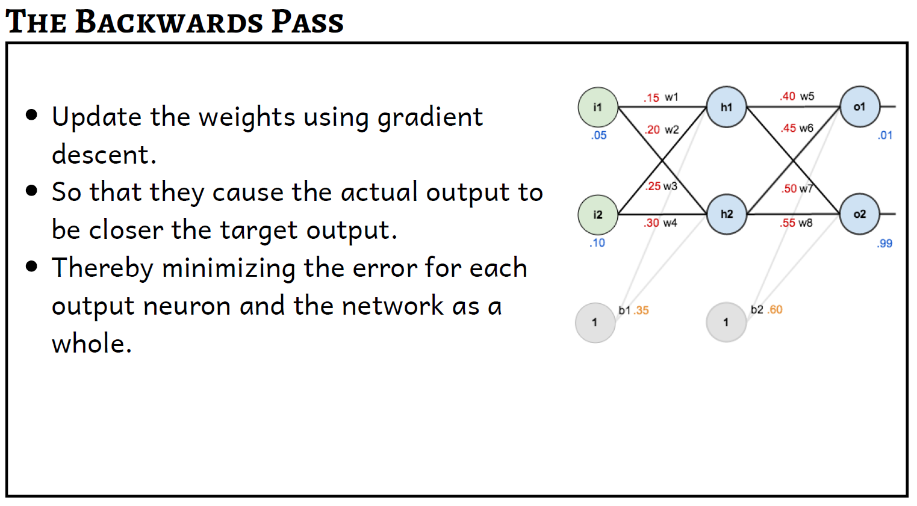

Slide 51
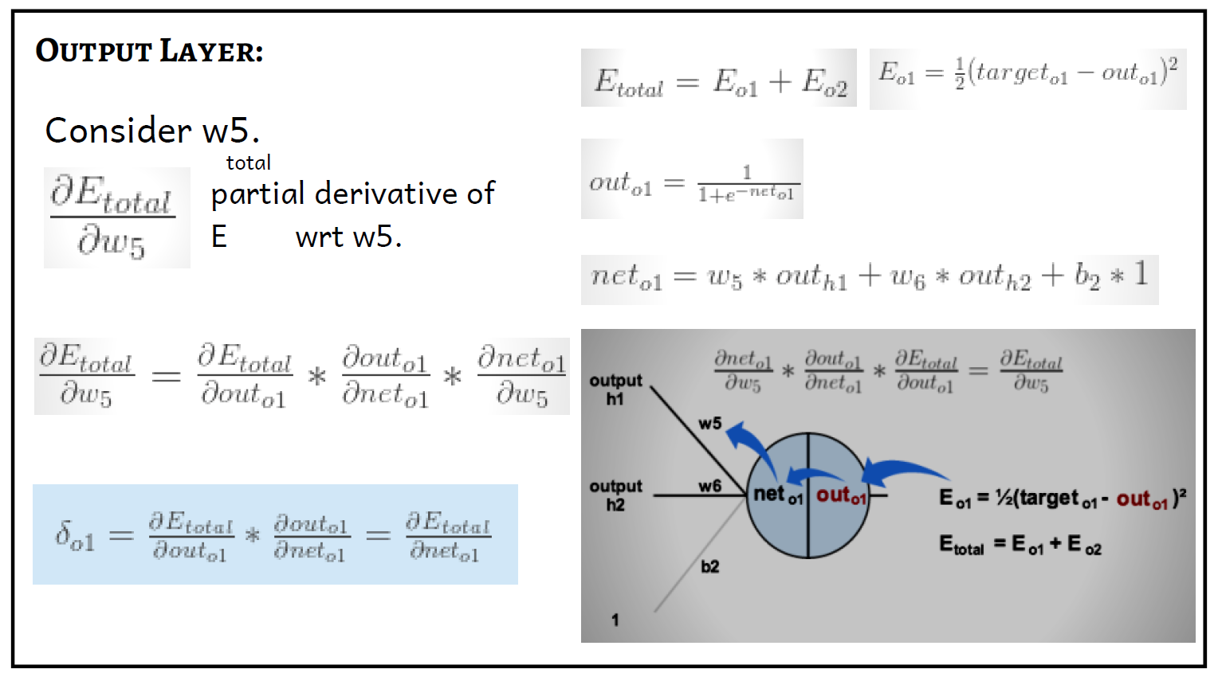

Slide 52
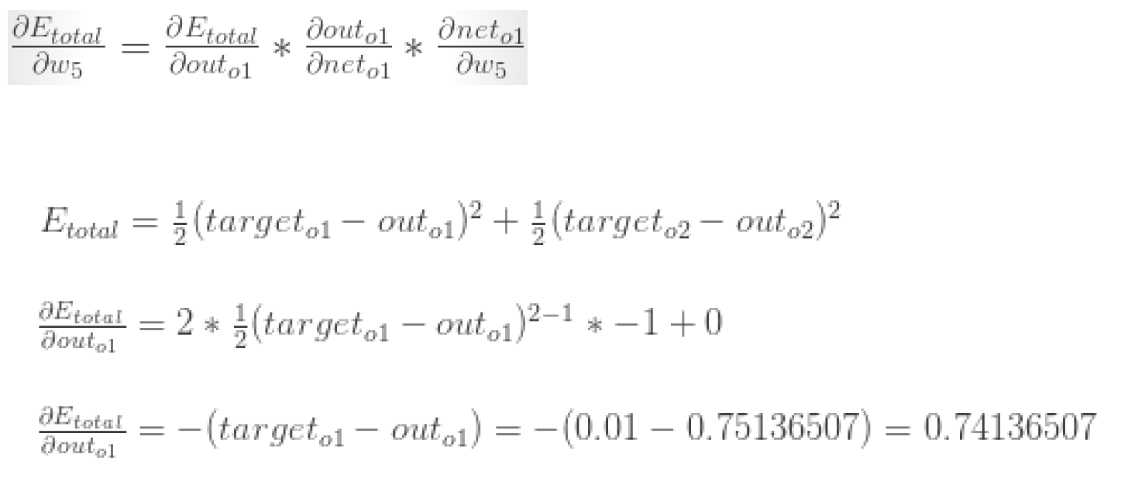

Slide 53
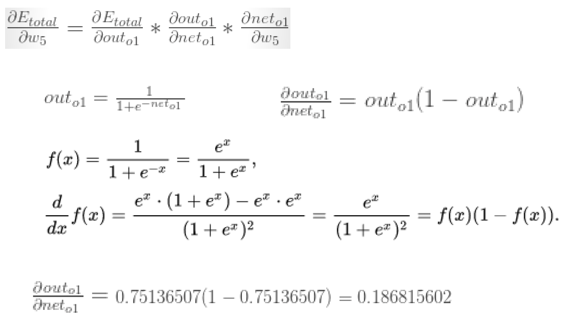

Slide 54
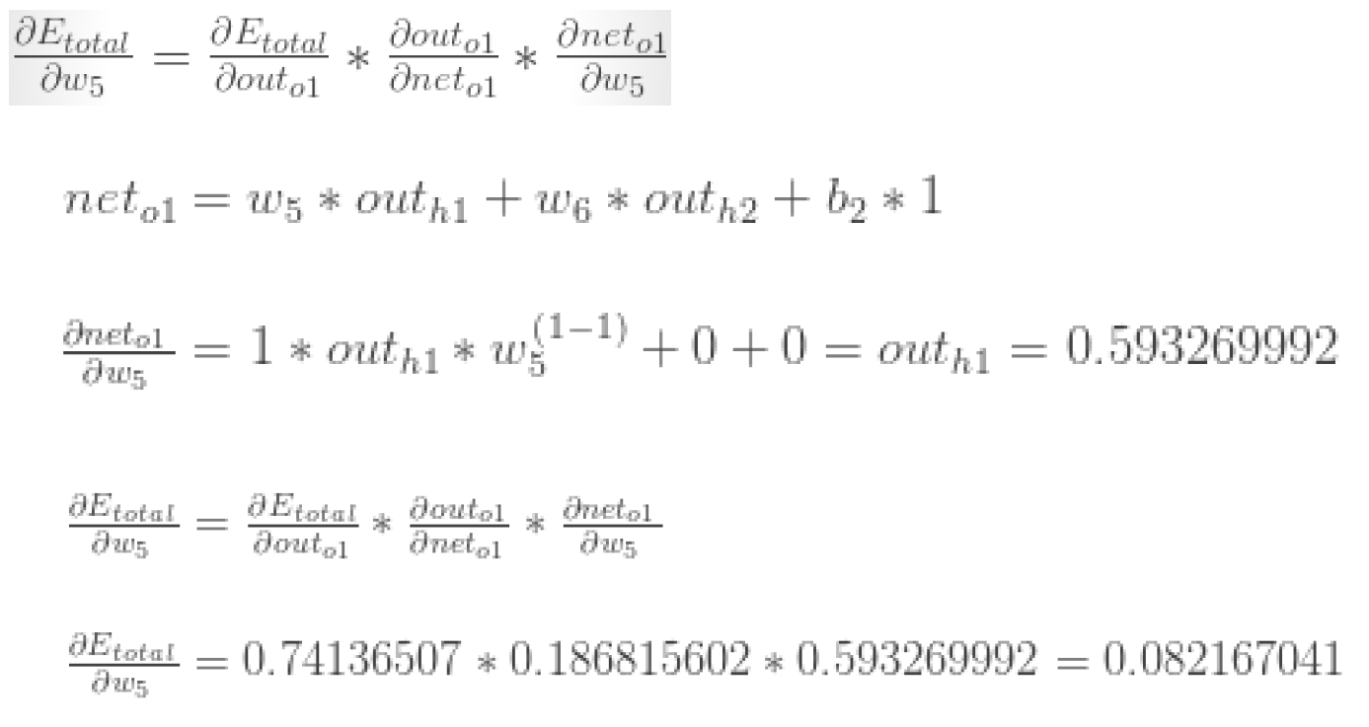

Slide 55
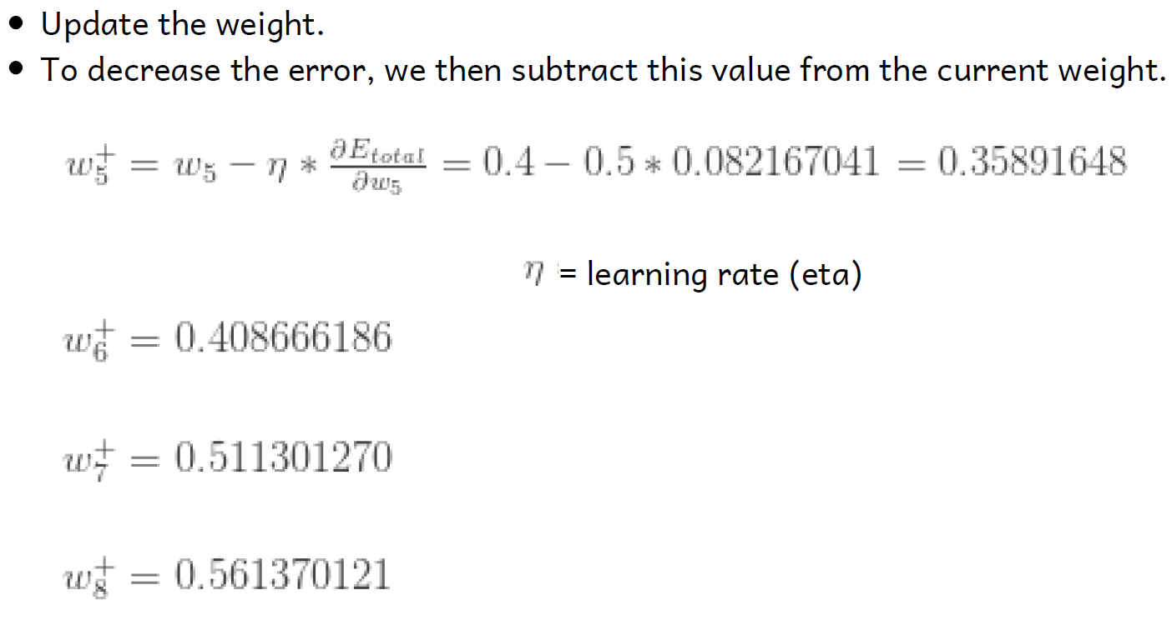

Slide 56
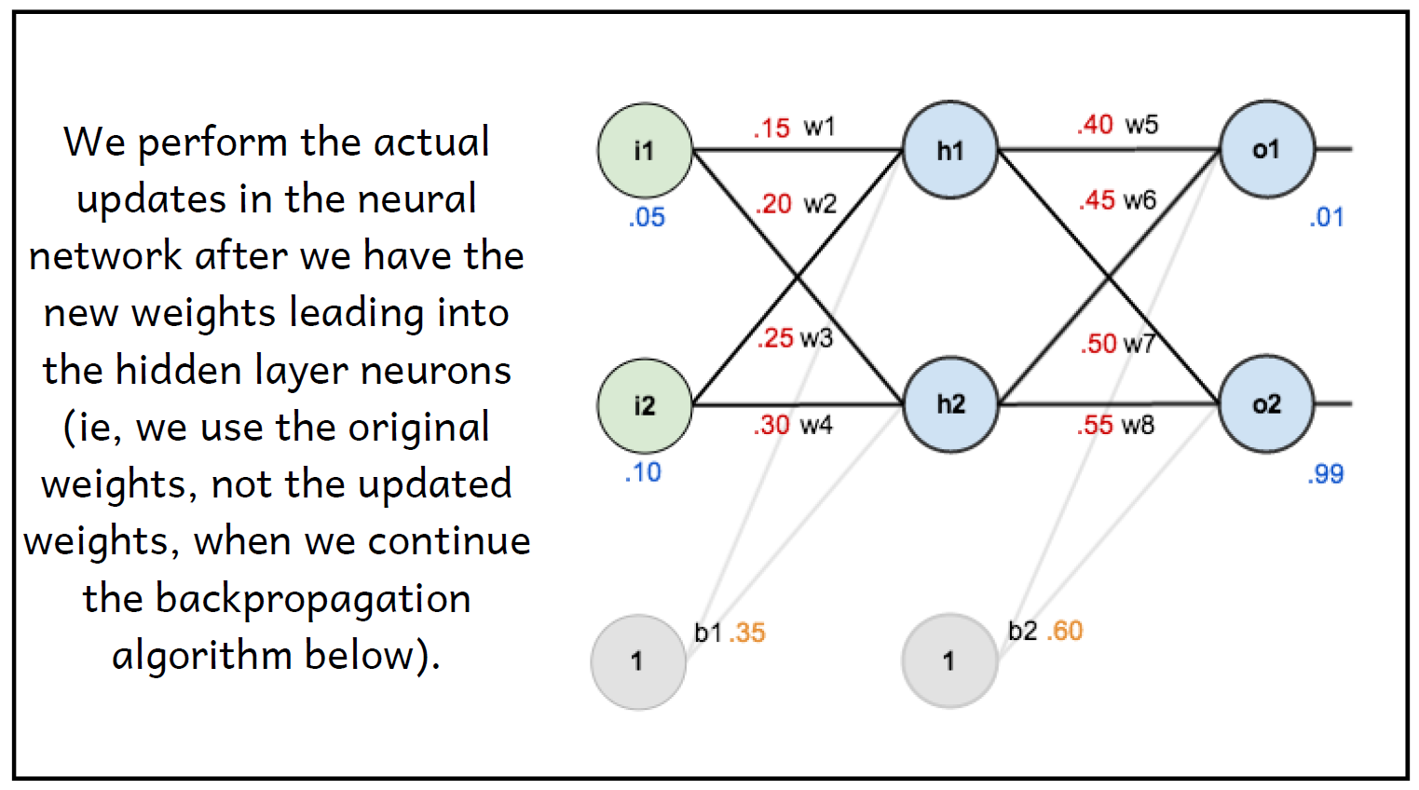

Slide 57
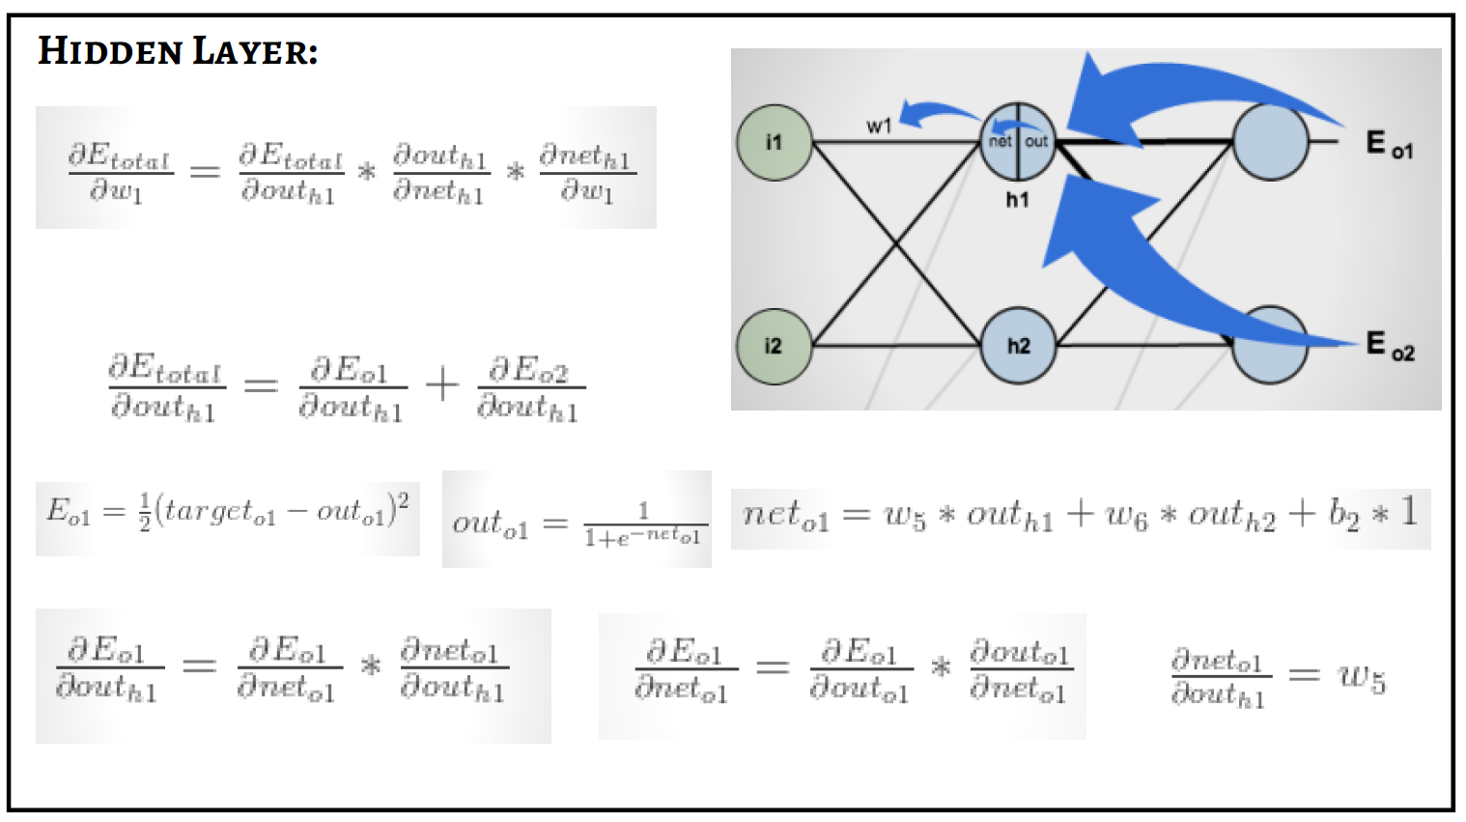

Slide 58
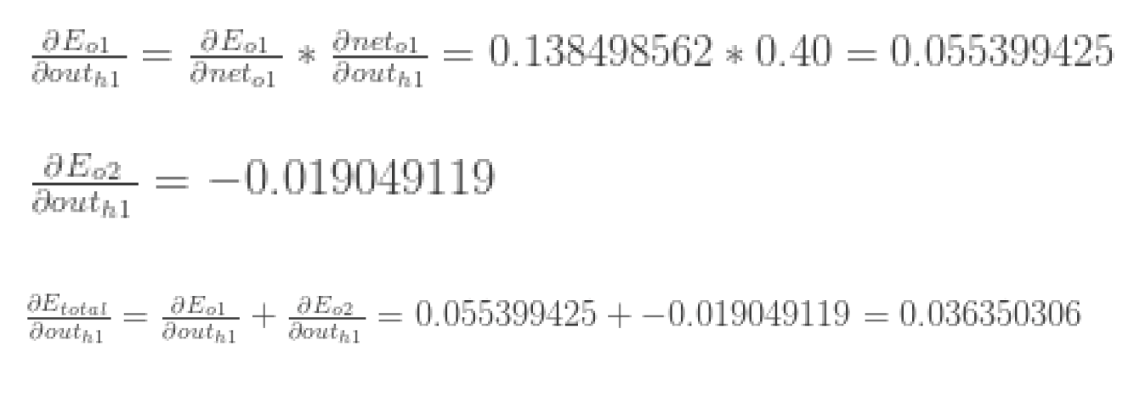

Slide 59
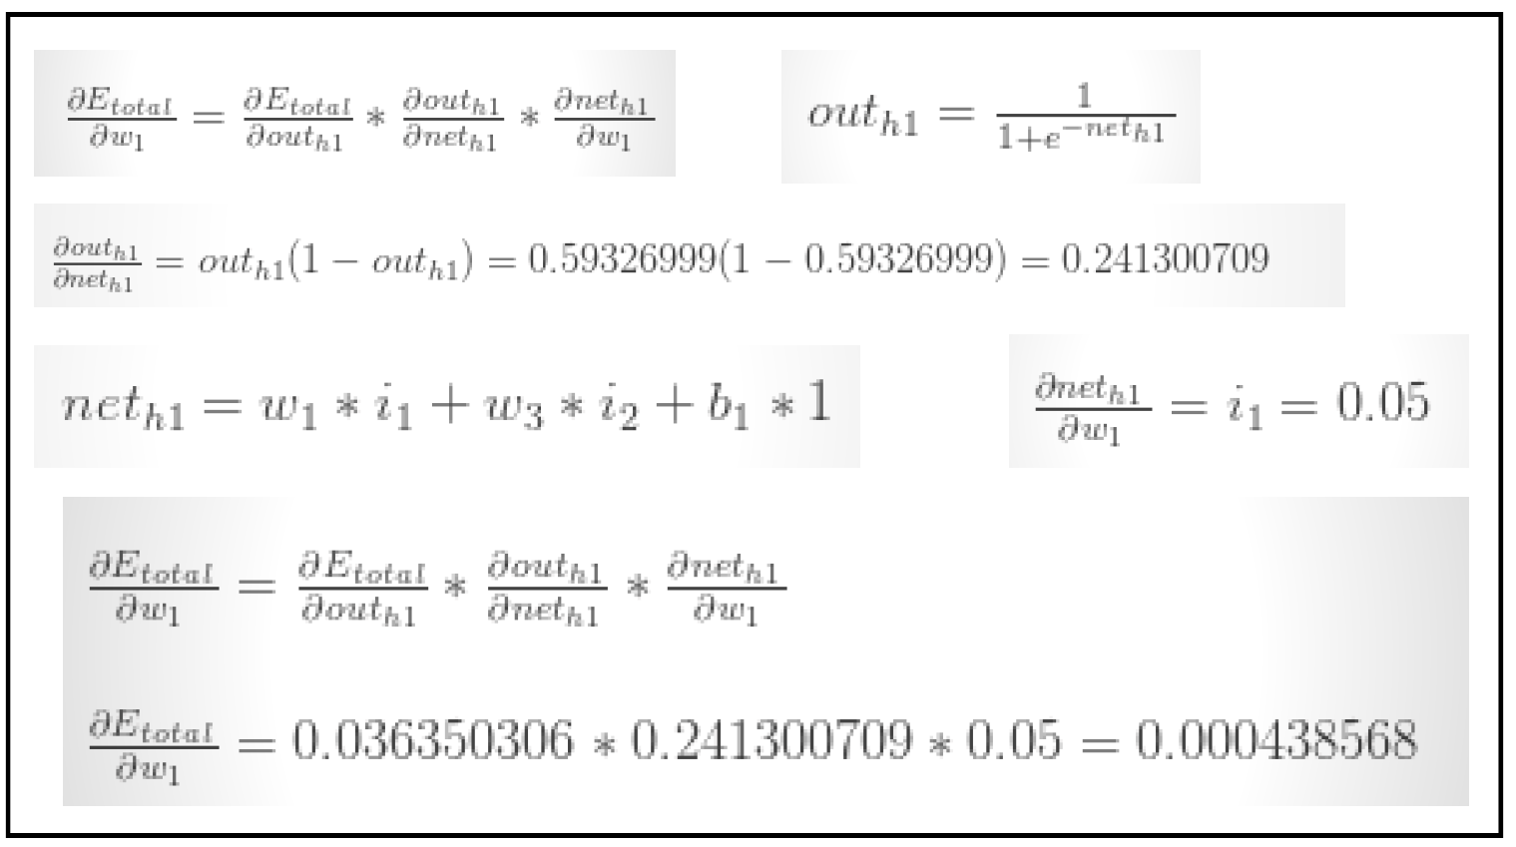

Slide 60
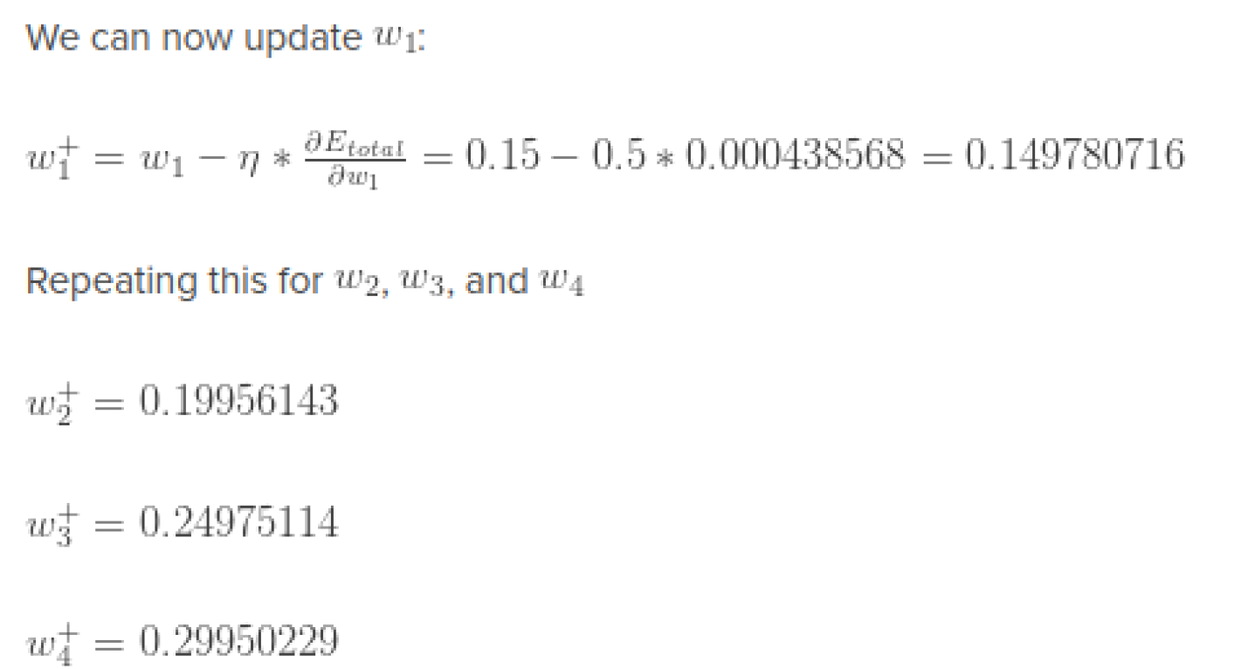

Slide 61
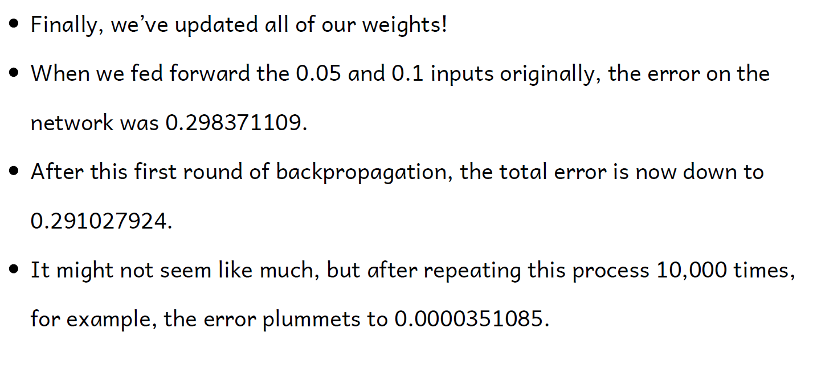

Slide 62
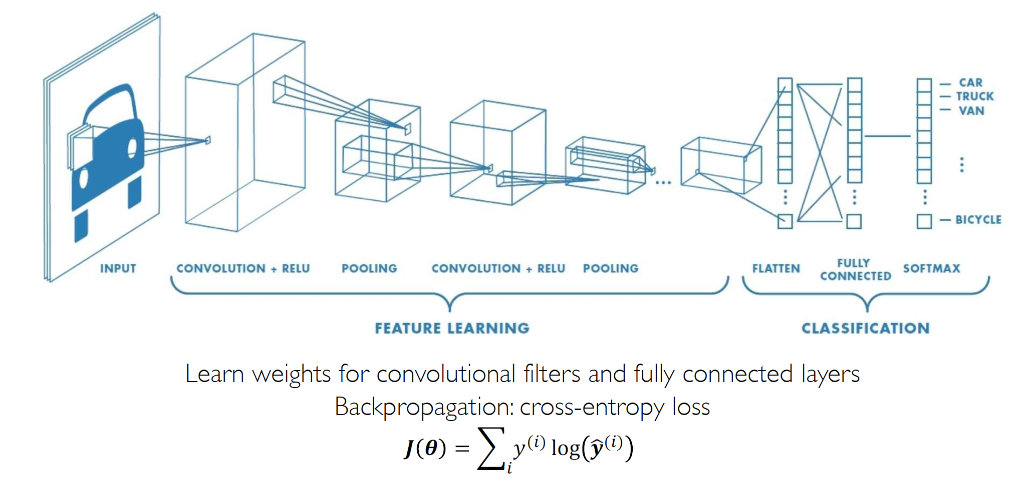
CNNs: Training with Backpropagation

Slide 63
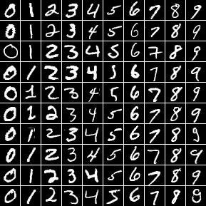
MNIST dataset
The MNIST database of handwritten digits,
available from this page,
has a training set of 60,000 examples, and a test set of 10,000 examples.
It is a subset of a larger set available from NIST.
The digits have been size-normalized and centered in a fixed-size image.

Slide 64
LeNet-5 CNN Architecture
In 1998, the LeNet-5 architecture was introduced in a research paper titled “Gradient-Based Learning Applied to Document Recognition” by Yann LeCun, Leon Bottou, Yoshua Bengio, and Patrick Haffner.
It is one of the earliest and most basic CNN architecture.
Architecture:
It consists of 7 layers.
The first layer consists of an input image with dimensions of 32×32.
It is convolved with 6 filters of size 5×5 resulting in dimension of 28x28x6.
The second layer is a Pooling operation which filter size 2×2 and stride of 2. Hence the resulting image dimension will be 14x14x6.
The third layer involves in a convolution operation with 16 filters of size 5×5.
The fourth layer is a pooling layer with similar filter size of 2×2 and stride of 2. Thus, the resulting image dimension will be reduced to 5x5x16.

Slide 65
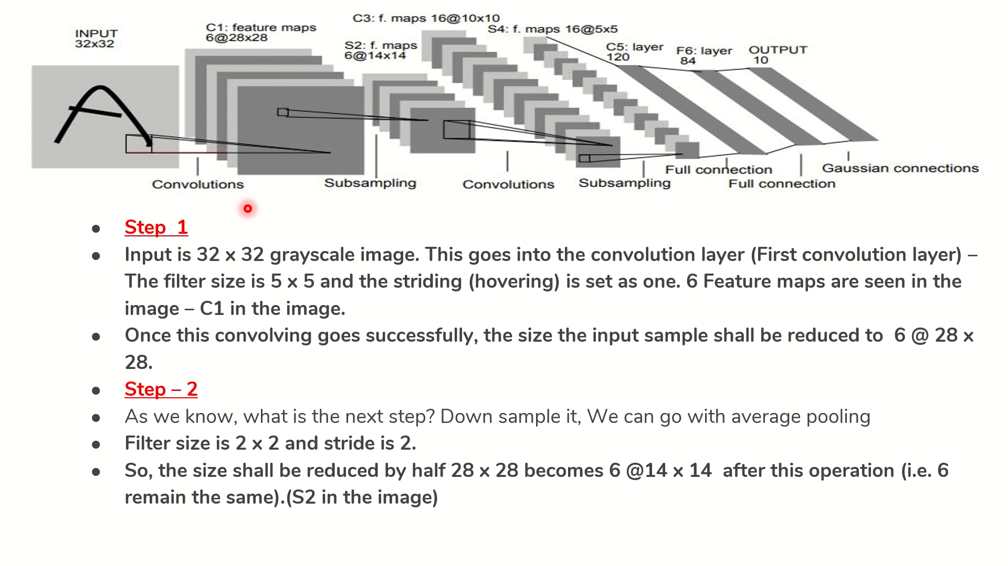

Slide 66
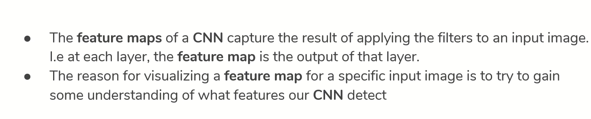
Feature Maps

Slide 67
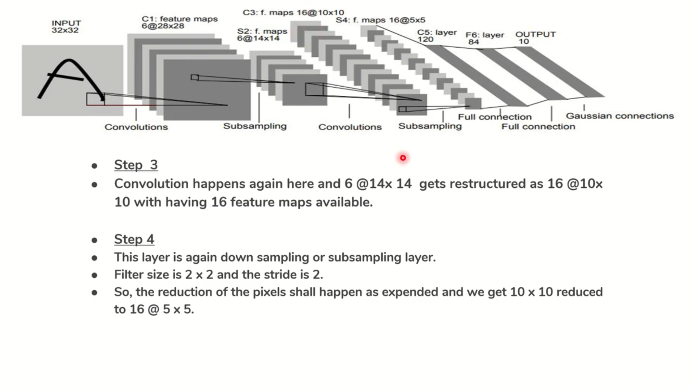

Slide 68
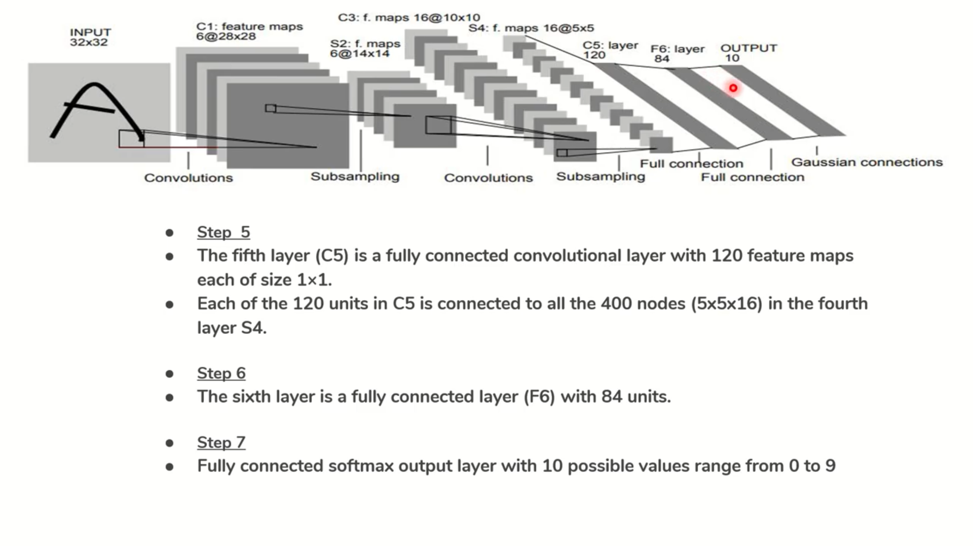

Slide 69
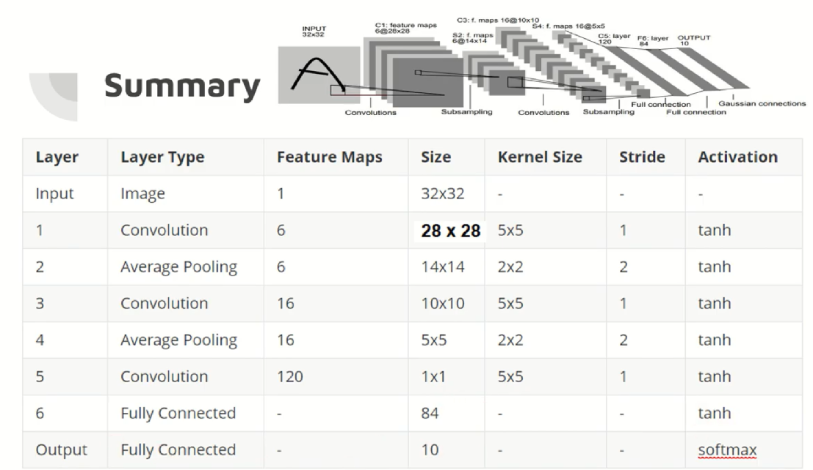

Slide 70
AlexNet CNN Architecture
AlexNet is one of the most popular neural network architectures to date. It was proposed by Alex Krizhevsky for the ImageNet Large Scale Visual Recognition Challenge (ILSVRV), and is based on convolutional neural networks.
The challenge was to develop a Deep Convolutional Neural Network to classify the 1.2 million high-resolution images in the ImageNet LSVRC-2010 dataset into more than 1000 different categories.
Architecture:
It consists of 8 layers in total, out of which the first 5 are convolutional layers and the last 3 are fully-connected.
The first two convolutional layers are connected to overlapping max-pooling layers to extract a maximum number of features. The third, fourth, and fifth convolutional layers are directly connected to the fully-connected layers.

Slide 71
AlexNet CNN Architecture
All the outputs of the convolutional and fully-connected layers are connected to ReLu non-linear activation function.
The final output layer is connected to a softmax activation layer, which produces a distribution of 1000 class labels.
The input dimensions of the network are (256 × 256 × 3), meaning that the input to AlexNet is an RGB (3 channels) image of (256 × 256) pixels.
There are more than 60 million parameters and 650,000 neurons involved in the architecture.
To reduce overfitting during the training process, the network uses dropout layers. The neurons that are “dropped out” do not contribute to the forward pass and do not participate in backpropagation. These layers are present in the first two fully-connected layers.

Slide 72
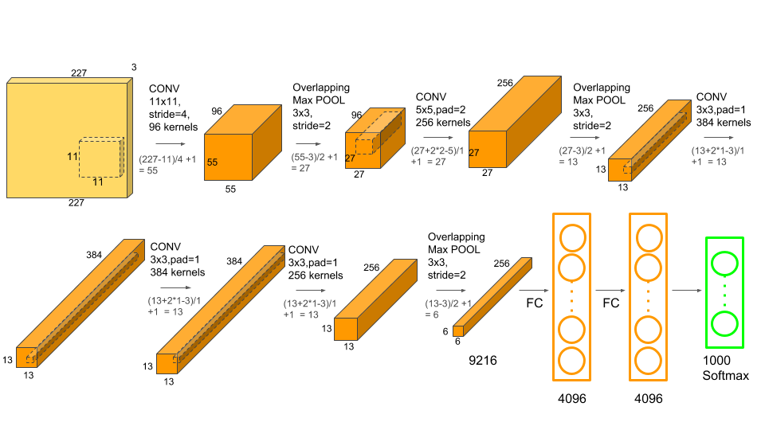
AlexNet CNN Architecture

Slide 73


Slide 74
Other CNN Architecture
VGG16
VGG19
RasNet-18
ResNet-50
GoogleNet etc.

Slide 75
Challenges of Deep Learning
Works better with large amount of data •
Some models are very hard to train, may take weeks or months
Overfitting
Black box and hence may have regulatory challenges

